Slide 1

Barnyard Weather Fun: Cows and Raccoons An update and musings from the world of storm based warnings, severe weather archives, and general trouble making.
Daryl Herzmann
Iowa State University

Slide 2
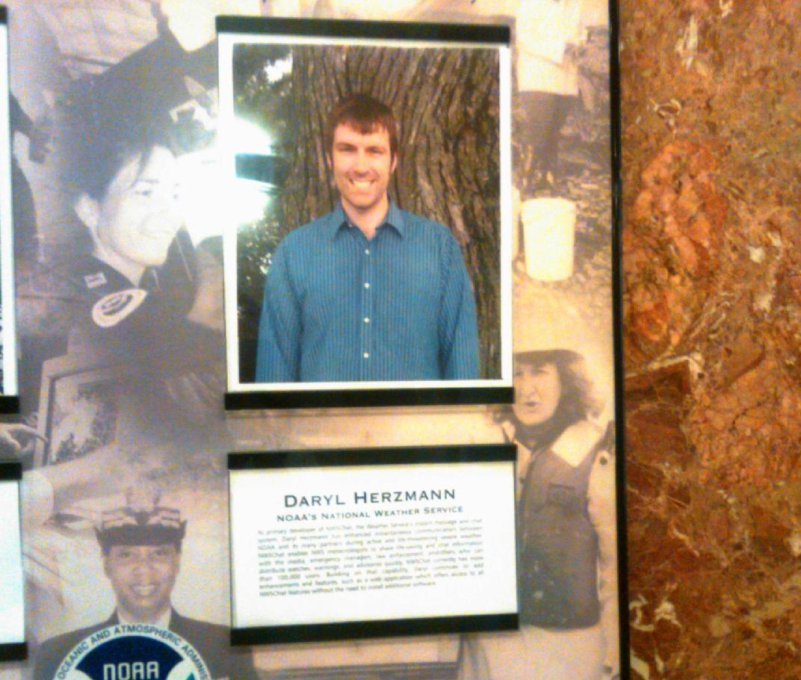
Diplomatic Immunity (June 2012 NOAA Team Member of the Month!)

Slide 3
Indisputable Fact of Life #1
The weather bureau is currently unable to issue storm based warnings.

Slide 4
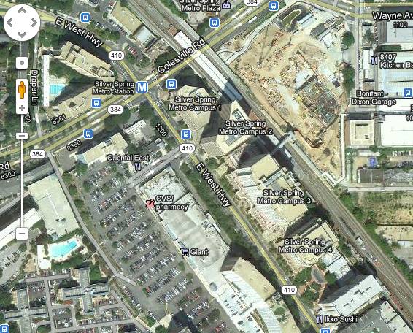
The reason why

Slide 5
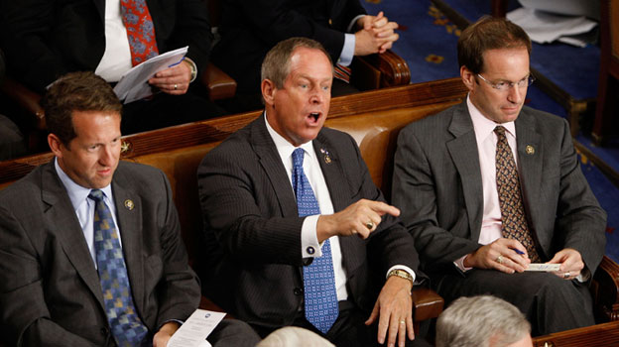
Oh, you don’t agree?

Slide 6

So I challenge you:
Go to your fancy AWIPS station and draw me a storm based warning for a tornado spotted:
Shelby, NE
Hamburg Bend Conservation Reserve
St Petersburg, FL

Slide 7
Oh, you still don’t agree?
(Or, everyone does agree because this is such a smart office or is adverse to confrontation)

Slide 8
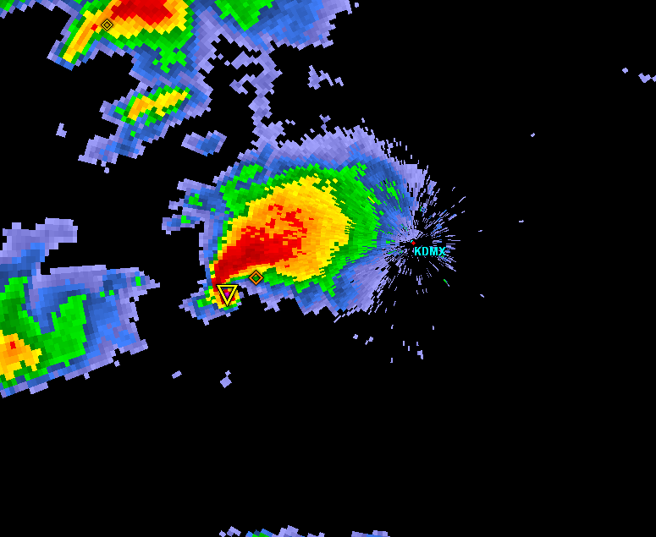
Warning Process Evaluation
Garden Variety Tornado
We had better warn.

Slide 9
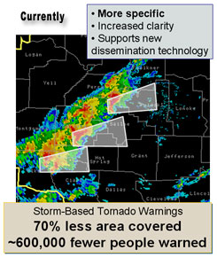
Warning Process Evaluation
Yippee, we can use our fine training and draw a polygon!

Slide 10
Warning Process Evaluation
I draw my fancy pants polygon out for 30 minutes.
I’m done, right?

Slide 11
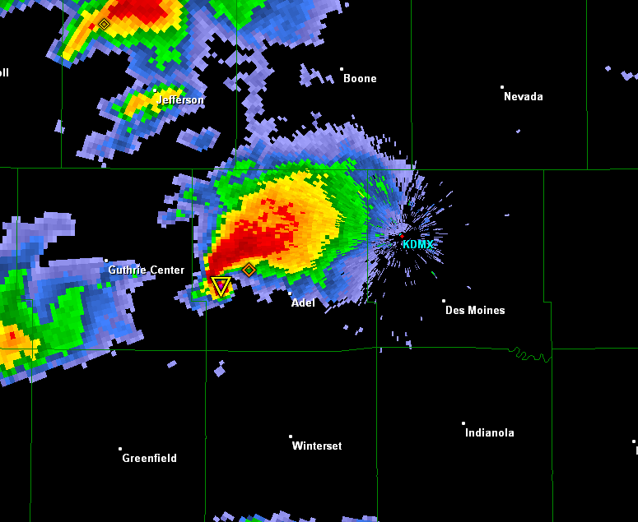
daryl’s here
Warning Process Evaluation
Gasp, I’m warning for 5 counties! Sirens will go off
In all 5!

Slide 12
daryl’s stays asleep
Warning Process Evaluation
WarnGen clipping to the rescue!

Slide 13
Warning Process Evaluation
Whoa, what happened?

Slide 14
Darn it daryl, I came here for stats (or free food), not altruistic hyperbole.

Slide 15
NWS County SVR/TOR Warnings
Storm Based Warnings
NEXRAD

Slide 16
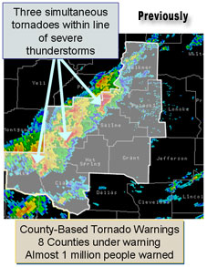
1 Oct 2007, warnings changed
http://www.weather.gov/sbwarnings/
“Storm-Based Warnings show the specific meteorological or hydrological threat area and are not restricted to geopolitical boundaries.”

Slide 17
But what actually changed? NWS: Ignore the red, use the yellow
291
WUUS53 KDMX 182302
SVRDMX
IAC007-117-125-135-181-182345-
/O.NEW.KDMX.SV.W.0171.100618T2302Z-100618T2345Z/
BULLETIN - IMMEDIATE BROADCAST REQUESTED
SEVERE THUNDERSTORM WARNING
NATIONAL WEATHER SERVICE DES MOINES IA
602 PM CDT FRI JUN 18 2010
THE NATIONAL WEATHER SERVICE IN DES MOINES HAS ISSUED A
* SEVERE THUNDERSTORM WARNING FOR...
NORTHWESTERN APPANOOSE COUNTY IN SOUTH CENTRAL IOWA...
NORTHEASTERN LUCAS COUNTY IN SOUTH CENTRAL IOWA...
SOUTHWESTERN MARION COUNTY IN SOUTH CENTRAL IOWA...
MONROE COUNTY IN SOUTH CENTRAL IOWA...
SOUTHEASTERN WARREN COUNTY IN SOUTH CENTRAL IOWA...
* UNTIL 645 PM CDT
* AT 600 PM CDT...NATIONAL WEATHER SERVICE DOPPLER RADAR INDICATED A
SEVERE THUNDERSTORM CAPABLE OF PRODUCING GOLF BALL SIZE HAIL...AND
DAMAGING WINDS IN EXCESS OF 60 MPH. THIS STORM WAS LOCATED 10
MILES NORTHEAST OF CHARITON...OR 36 MILES SOUTHEAST OF DES
MOINES...AND MOVING SOUTHEAST AT 30 MPH.
* LOCATIONS IMPACTED INCLUDE...
ALBIA...RUSSELL...MELROSE AND LOVILIA.
PRECAUTIONARY/PREPAREDNESS ACTIONS...
MOVE TO AN INTERIOR ROOM AND STAY AWAY FROM WINDOWS. IF YOU ARE IN A
MOBILE HOME...GET OUT NOW...AND SEEK SHELTER IN A REINFORCED
BUILDING.
A TORNADO WATCH REMAINS IN EFFECT FOR THE WARNED AREA. SEVERE
THUNDERSTORMS CAN PRODUCE TORNADOES WITH LITTLE OR NO WARNING. IF A
TORNADO IS SPOTTED...IMMEDIATELY MOVE TO THE BASEMENT OR SMALL
INTERIOR ROOM OF A REINFORCED BUILDING.
TORRENTIAL RAINFALL IS ALSO OCCURRING WITH THIS STORM...AND MAY LEAD
TO FLASH FLOODING. DO NOT DRIVE YOUR VEHICLE THROUGH FLOODED
ROADWAYS. TURN AROND DON'T DROWN.
&&
LAT...LON 4089 9310 4090 9310 4090 9313 4112 9357
4116 9357 4116 9358 4135 9335 4105 9272
4084 9301
TIME...MOT...LOC 2302Z 300DEG 28KT 4114 9321
WIND...HAIL 60MPH 1.75IN
$$
SMALL

Slide 18
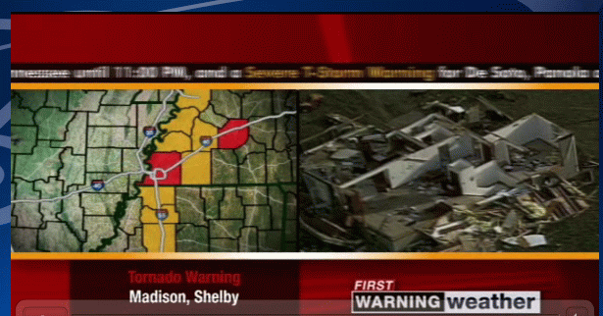
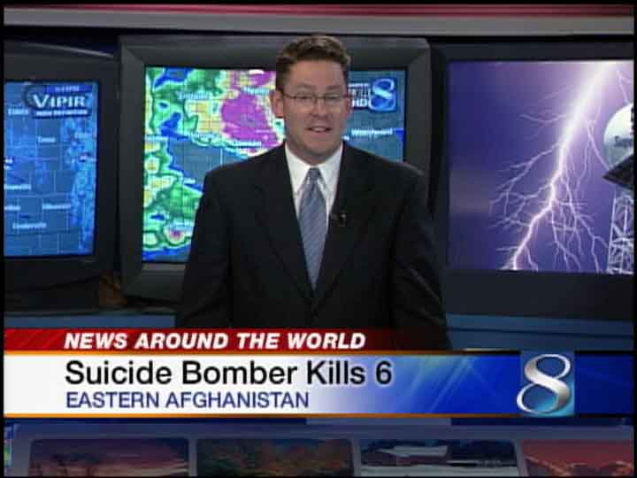
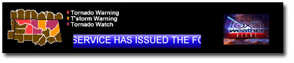
The private sector jumped to action
Comic Relief
Lifted from Barons and WXC website. Those
are county warnings!

Slide 19
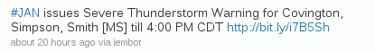

Thankfully, we have social media
Great job daryl on iembot !
….. FAIL .…

Slide 20
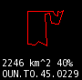
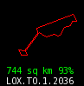
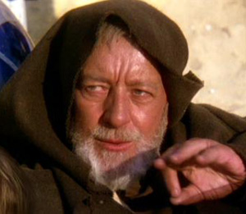
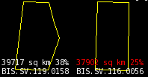
These aren’t the polygons you’re looking for
(Maryland == 26,000 sq km)

Slide 21
Oh daryl, you and your 1% type academic friends always focused on the outliers…. So another altruism: If less than 50% of warnings are “storm based”, can the program still keep its name?

Slide 22
Quiz Question #1 How do you cancel a portion of the warning?
Answer: Cancel one of the counties in the warning!
IAC181-182341-
/O.CAN.KDMX.SV.W.0171.000000T0000Z-100618T2345Z/
...THE SEVERE THUNDERSTORM WARNING FOR SOUTHEASTERN WARREN COUNTY IS
CANCELLED...
IAC007-117-125-135-182345-
/O.CON.KDMX.SV.W.0171.000000T0000Z-100618T2345Z/
...A SEVERE THUNDERSTORM WARNING REMAINS IN EFFECT FOR SOUTHWESTERN
MARION...MONROE...EASTERN LUCAS AND NORTHWESTERN APPANOOSE COUNTIES
UNTIL 645 PM CDT...

Slide 23
Quiz Question #2 What’s wrong with this picture?

Slide 24
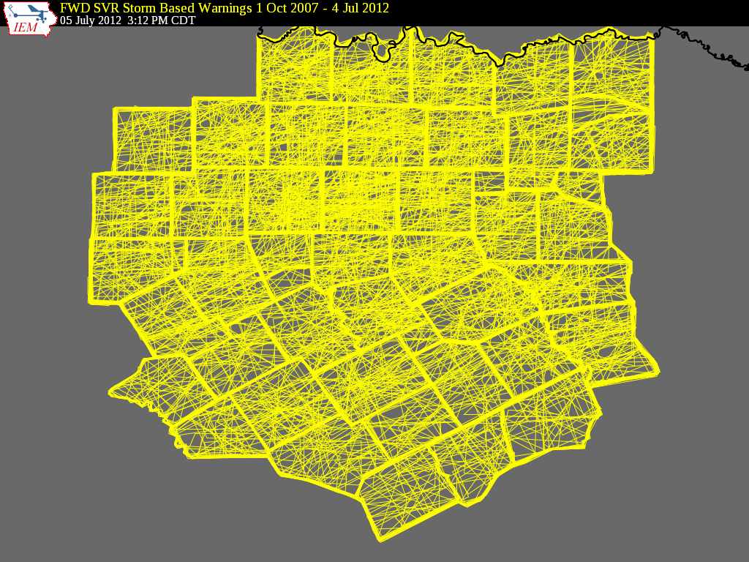

Slide 25
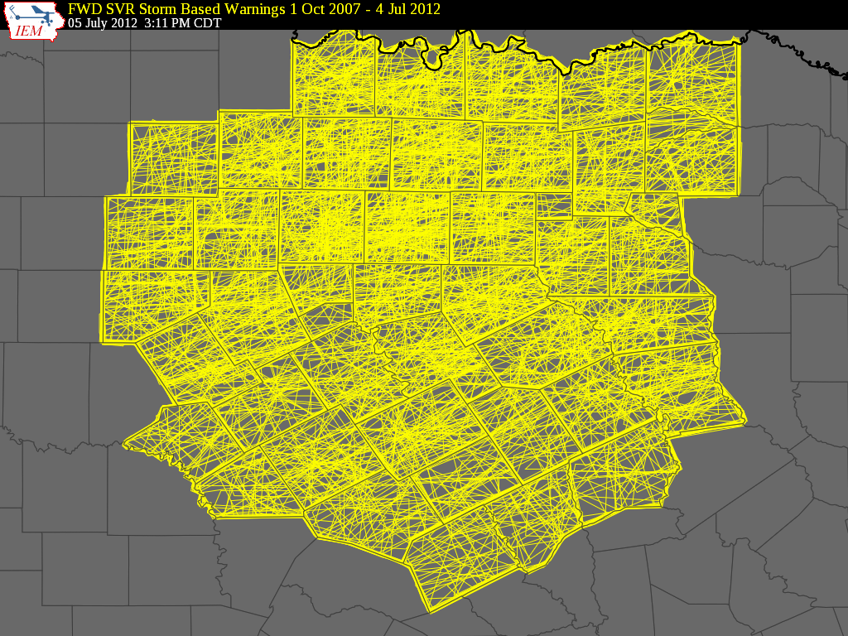

Slide 26

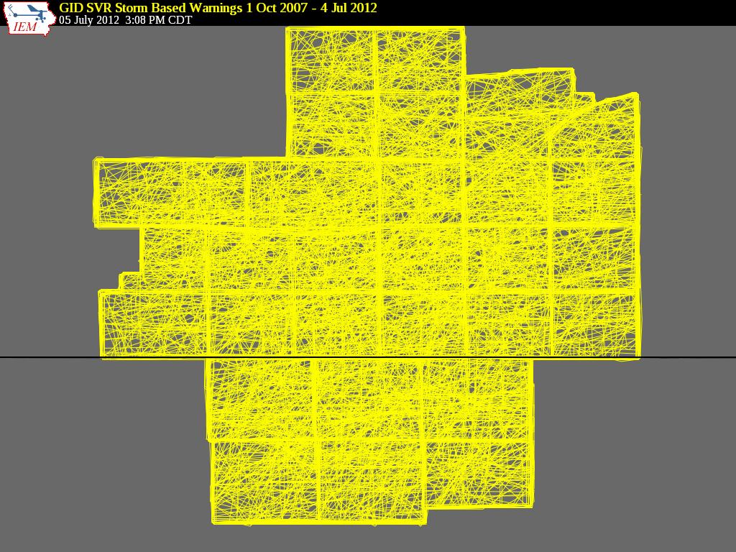

Bah, that is Texas, we are Hastings, fricken Nebraska

Slide 27
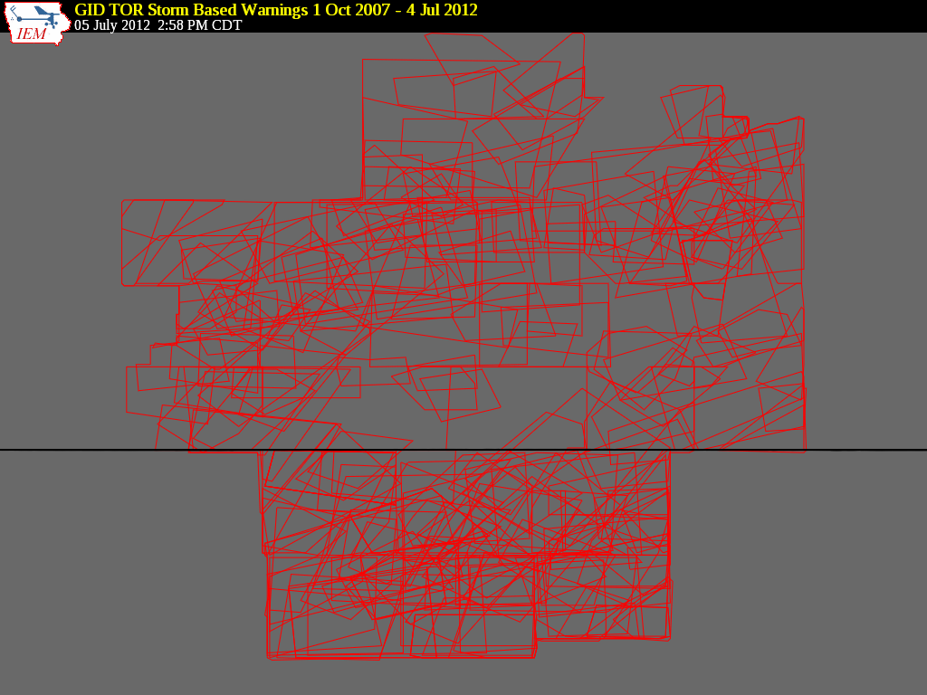
Bah, that is Texas, we are Hastings, fricken Nebraska

Slide 28
1 Oct 2007 – 23 Mar 2012: Number of Polygon Vertices (SVR+TOR)
~50%
~8%

Slide 29
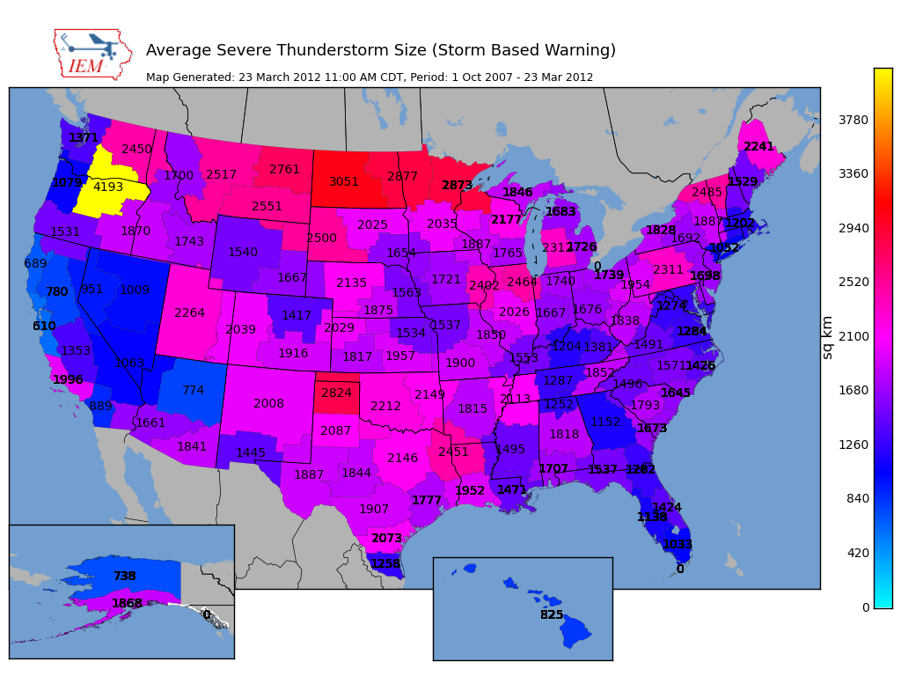

Slide 30
Average SBW Size Versus County Size per WFO (SVR+TOR shown, Alaska not included)

Slide 31
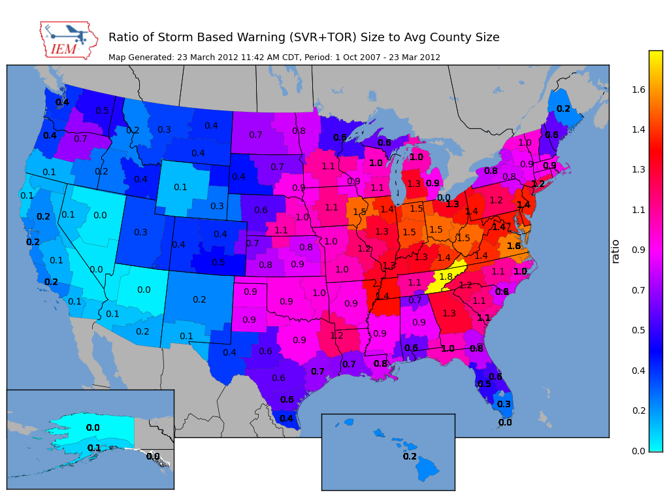

Slide 32
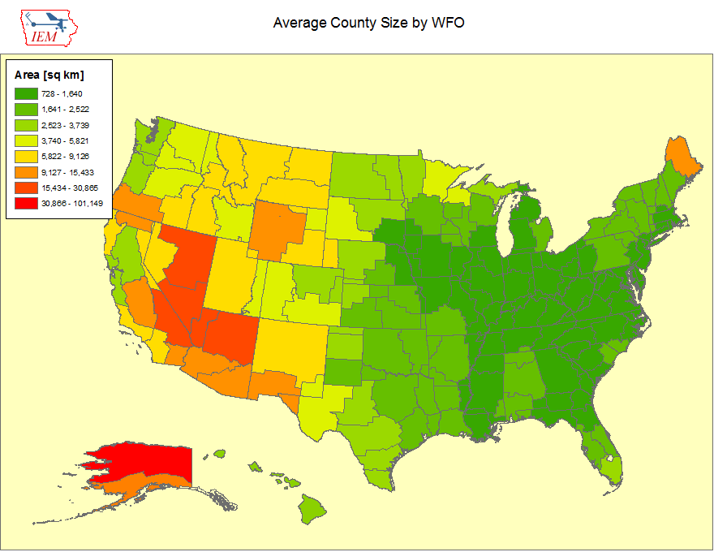

Slide 33
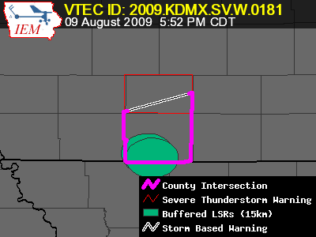
Lets get quantitative
Perimeter Influence
How much of the polygon perimeter coincides with a political boundary
Areal Verification
If the LSRs are buffered, what areal percentage verified
Size Reduction
How much smaller was the warning than the counties it was issued against.

Slide 34
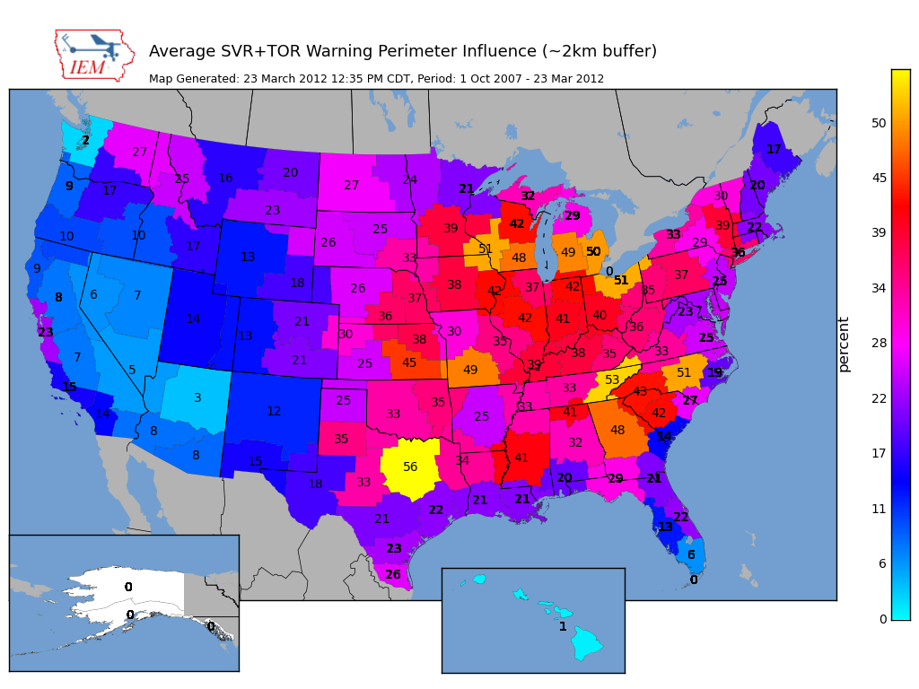

Slide 35
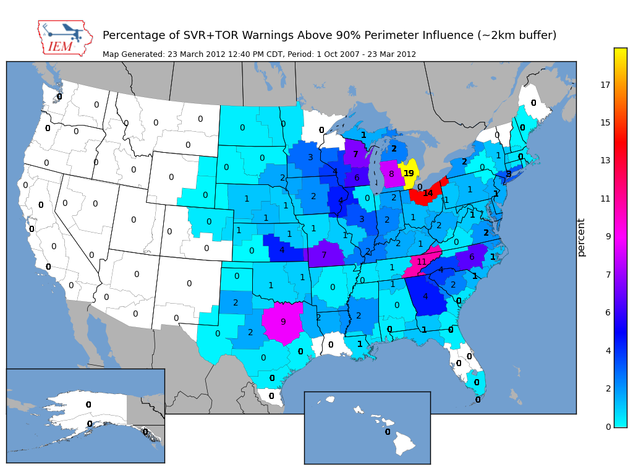
~ 2 % of all warnings

Slide 36
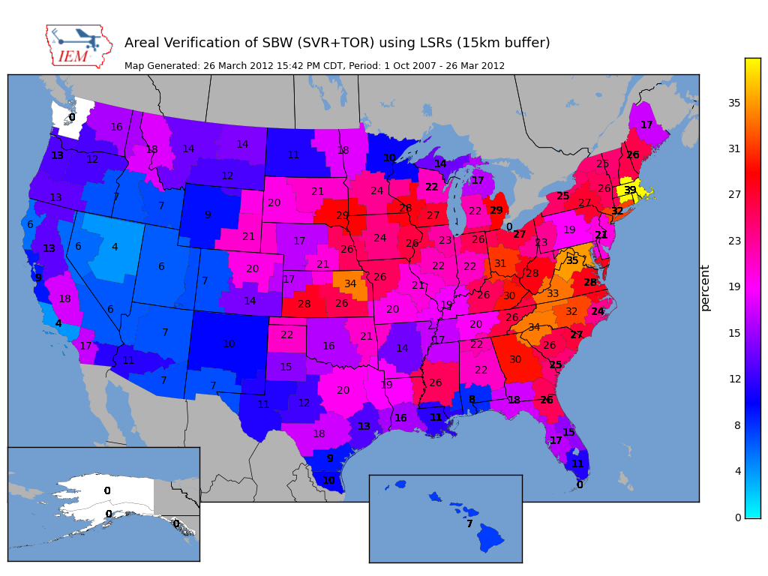
Nationwide is around 25%

Slide 37
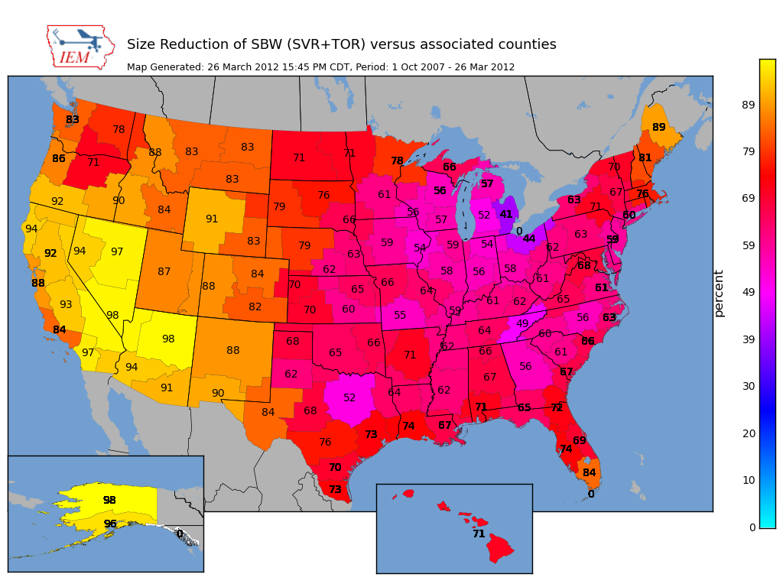
Nationwide Average: 65%

Slide 38
Oh daryl, what about this?
Perimeter ratio is small
So lets compute another metric measuring distance of vertex to county border
County
Warning

Slide 39
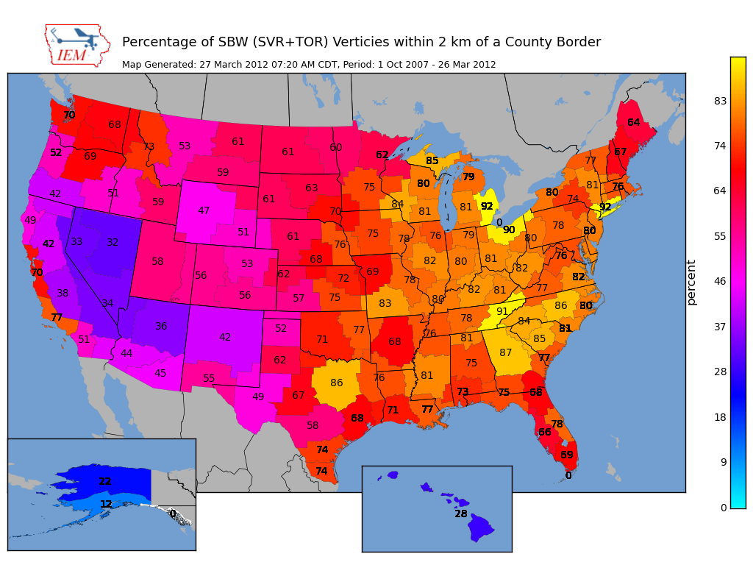
Overall Average: 75%
Overall: 75%

Slide 40
Are warnings centered on the storm?
Compute centroid of TIME…MOT…LOC
Compare against Polygon Centroid

Slide 41
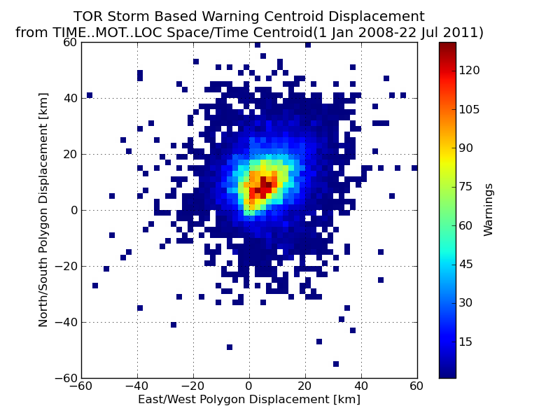

Slide 42
Does the warning track the storm in space?
Compute moving threat TIME…MOT…LOC
perpendicular to motion vector, compute
report displacement

Slide 43
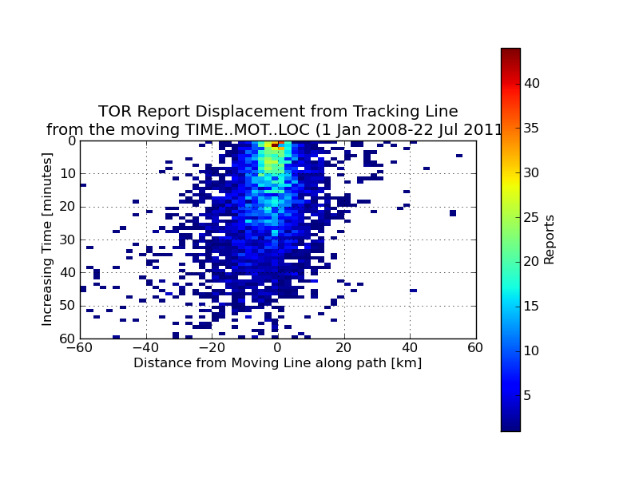
Most reports are 0-10 km south of the
TIME…MOT…LOC

Slide 44
More tracking fun
Does storm tracking accuracy
decrease with time?

Slide 45
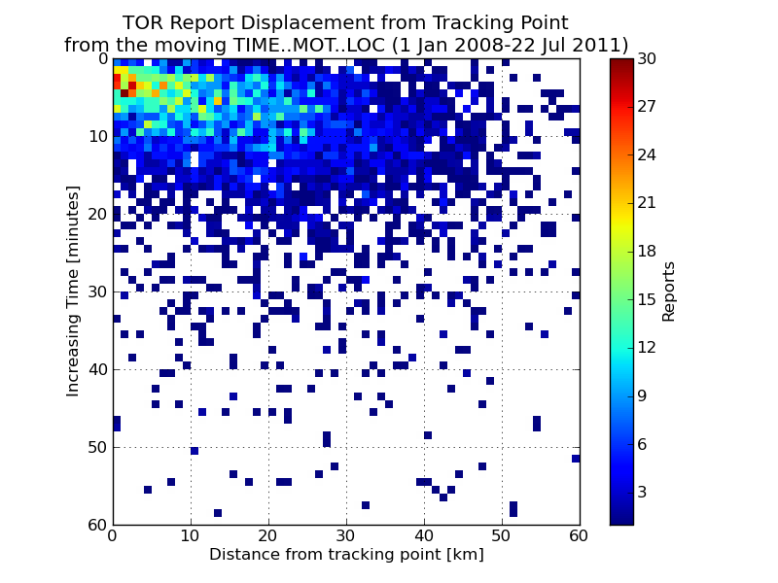

Slide 46
Academic Thought Experiment
Take TIME..MOT.LOC and draw my own warning:
30 min duration
~10 km left
~10 and increase to 30 km to the right
Which will #win ?

Slide 47
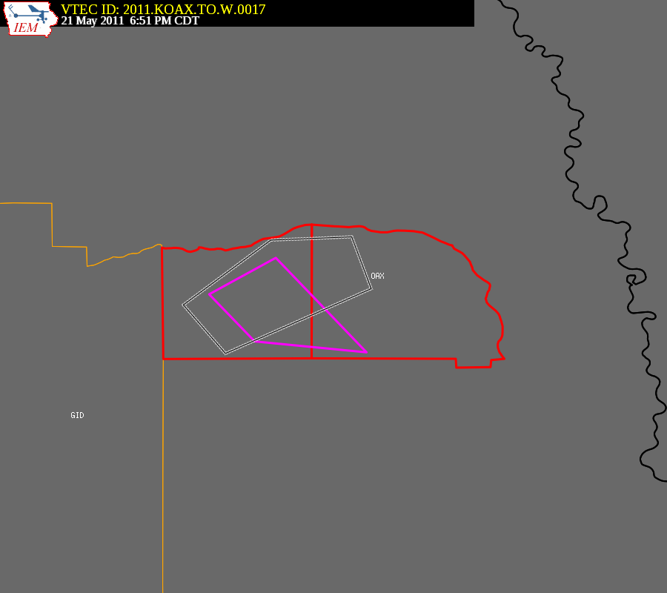
Purple box is the warning from
the automated algorithm

Slide 48
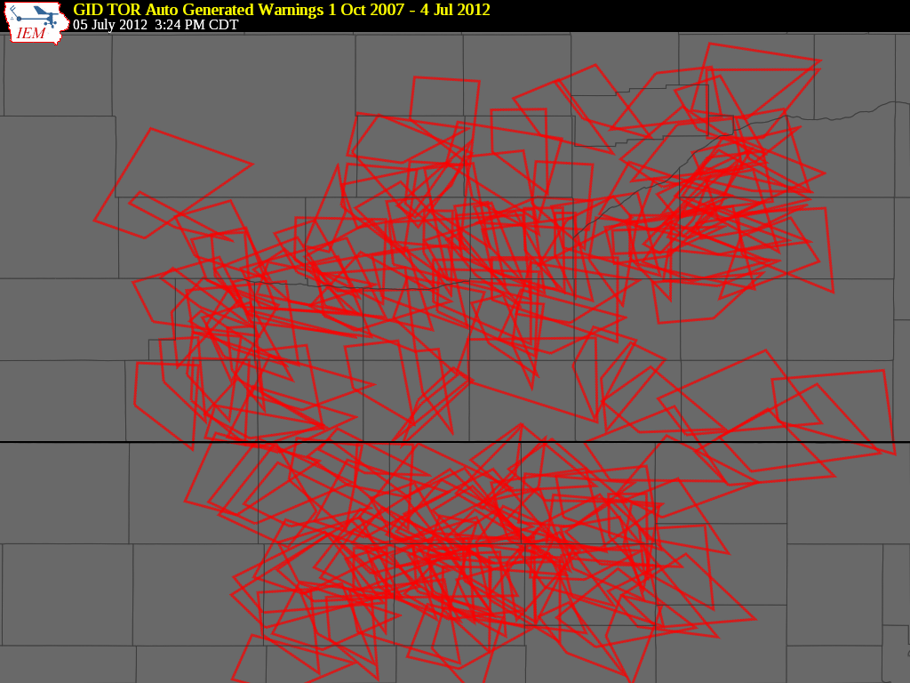

Slide 49

Hastings’ TORs 2008-2011
 | WEATHER BUREAU | ACADEMIA
Average Size (sq km) | 1019 | 685
Areal Verification | 15.3% | 15.2%
Vertex County Intersection | 60.9% | 20.5%
Size Reduction | 74.3% | Didn’t Compute
Perimeter Ratio | 21.8% | 24.7%
Probability of Detection | 0.83 | 0.74
False Alarm Rate | 0.72 | 0.74
Critical Success Index | 0.27 | 0.24
Did the weather
bureau #win?

Slide 50
What is broken?
The warnings are constrained by political boundaries!
NWS Office can’t issue outside CWA
Warning product (VTEC) is still bound to UGC codes
Can’t issue SVR/TOR over Marine Zones, why ?!?!
No penalty for warning size in verification
Warning issuance software
Warning dissemination software (bad daryl)
Warning display software (bad daryl)
Some local NWS Office policies conflict with NWS directives, where’s the sheriff?
No topology checks, invalid geometries are OK

Slide 51
Summary
~ 25% of TOR/SVR Warnings are 4 sided
Only ~ 2 % of all SVR/TOR warnings are pure county retracements
~ 75% of polygon vertices are guided by county borders
SBWs have cut the size of warnings by over 60%, but the number of warnings has increased by 60%.
The Cubs will not win the World Series this year

Slide 52

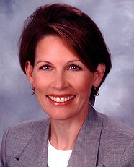
Is this the solution?

Slide 53
Equally, unrealistic solutions
Warnings should be data, not products
Computers are the most important readers…
UGC codes should not be included
Warnings should come from NWS, not WFOs
NWS should be working as a team, instead of theifdoms
Polygons should be limited to 4 to 6 sides.
The Cubs develop talent from their farm system and not overpay for free agents that struggle with the rigors of playing left field.

Slide 54
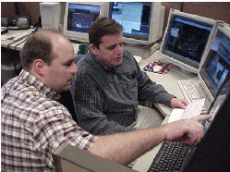



NWS Issues Products
Forecaster tries to figure out what the public wants
Disseminates
Public doesn’t call
Congress.
Computer angry!
NWS Issues Data
Computers deal with various users
Disseminates
Computer happy!
Meathead happy!

Slide 55
Apps & Archives
(less controversial)

Slide 56

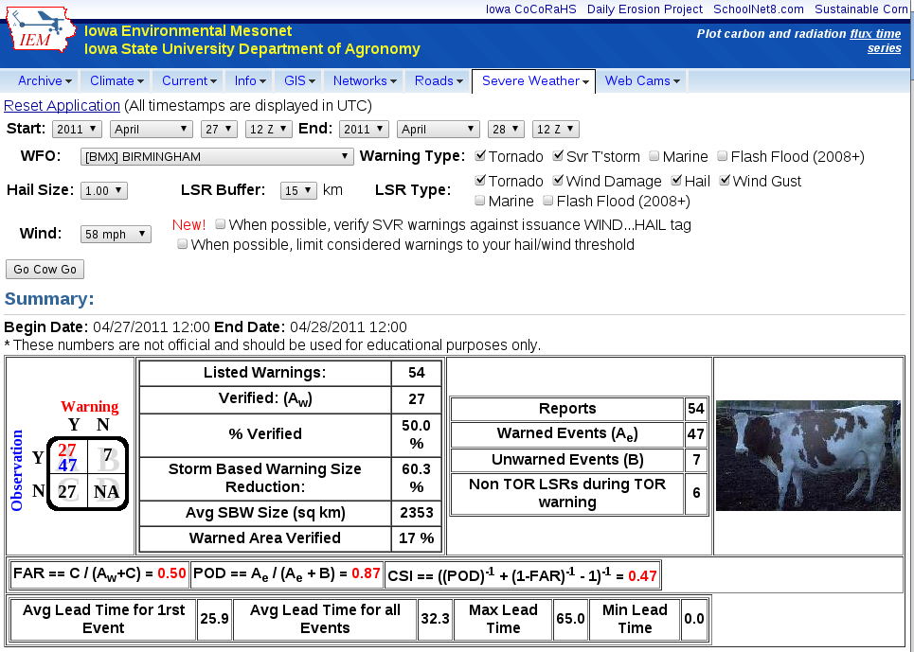
IEM Cow
SBW Verification based on Local Storm Reports, not Storm Data
Provides geometry stats on polygon
Handy way to review event data
It is ‘live’ and accurate at the time of page load

Slide 57

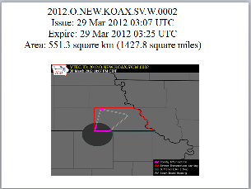
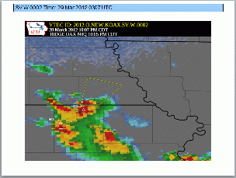
IEM Raccoon
OAX’s Dan Nietfeld gave me the idea
Create simple and quick Powerpoints of SVR,TOR warning events
Intended use:
Internal Office review of events
Quick materials for presentations
Improvements coming!

Slide 58
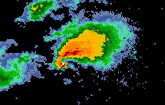
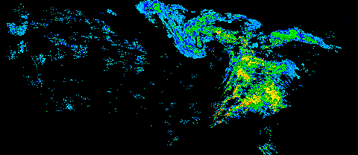
NEXRAD Archives
1km composite every 5 minutes back to 1995
Single site imagery since 1 Jan 2012 (backfilling ongoing)
Iowa NEXRADs are backfilled.
GIS Ready!

Slide 59
Other Archives of Interest
App to quickly view text products by center by date or range of dates
Processed SHEF archive back to 2010
Shapefile download of VTEC warnings and Local Storm Reports
Nearly complete archive of ASOS/AWOS processed data and raw METARs
Processed MOS archive since 2007

Slide 60

Time for Questions?
mesonet.agron.iastate.edu
Daryl Herzmann
515.294.5978
akrherz@iastate.edu

